Slide 1

Create Your Own Superhero!
IF YOU ENJOYED THIS LESSON AND WANT MORE, CHECK OUT OUR FAMOUS
MINDSET MASTERY SEL CURRICULUM AT
https://www.legacymasteryacademy.org/sel-curriculum
Module 6: Living With Purpose

Slide 2
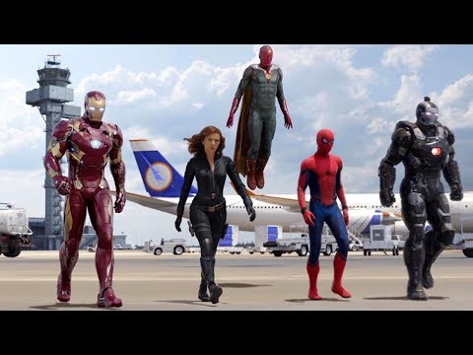

Explore
Superhero Video: (Video 1min:15sec)
What do all superheroes have in common?
3min
Notes:
Strengths, weaknesses, normal versions, not happy, all unique/something special, take challenge, call, courage despite fear, fight big battles,

Slide 3

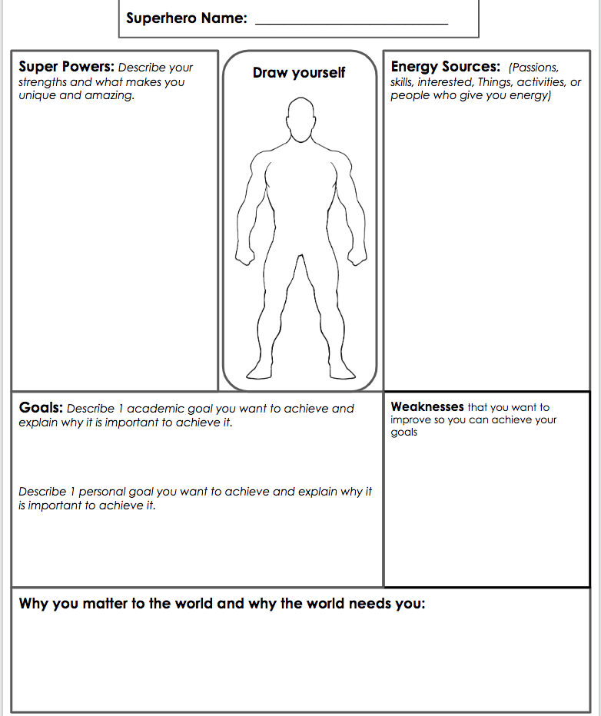
Create Your Superhero
Why?
Goals bring out our best
To know what we want out of life
To know our weaknesses so we can improve them
To remind ourselves that we matter
To remember that we have strengths and energy sources that will help us succeed.
Successful people constantly learn about themselves
Notes:
5min: T=45min (Transformed School Culture) - how this strategy turned around classrooms.
Appreciation: thank you, please, certificate, gift card (Staff recognition ideas), fill my cup.
CCEI- invest
How did that feel? Give = receive. Show evidence. Universal law. Company example. Relationship. At home, spouse, child, ex. Transformed school cultures with this. (students, staff, students to teachers, etc)

Slide 4


Stop Here
GOT FEEDBACK?
Do you have feedback, concerns, questions, and best practices to share?
Click here to complete our quick 1 min feedback form!

