Slide 1
Lesson 5: How has our journey empowered us?
FOR MORE LESSONS LIKE THIS, CHECK OUT OUR FAMOUS MINDSET MASTERY SEL CURRICULUM AT
https://www.legacymasteryacademy.org/sel-curriculum
Module 0: Creating a Mindset Family Culture

Slide 2
General:
Computer
LCD Projector
Speakers
Handouts and Materials:
Journey Timeline Handout One per student. Very Important: The teacher will need their personal completed journey timeline for modeling to students. Please prepare in advance. See lesson plan for examples.
Stickers (small) 3 per student for the journey timeline debrief (see below). Or another option is that students can just write a star for their recognitions. The stickers have had the most impact because it is more kinesthetic and provides a sense of pride and appreciation during the activity.
Extension (Optional):
Document Camera to project your own personal Journey Timeline.
Teacher
Materials

Slide 3
Lesson 5: How has our journey empowered us?
Module 0: Creating a Mindset Family Culture
Notes:
1min: T=1min
30sec: Have a student read the essential question. “_______, can you read the essential question for us? Thank you!”
30sec: “Now, think about why this topic today is important for you. How will answering this question benefit you?”
Extension Opportunity: Have students discuss with their partners why this topic is important to them.

Slide 4
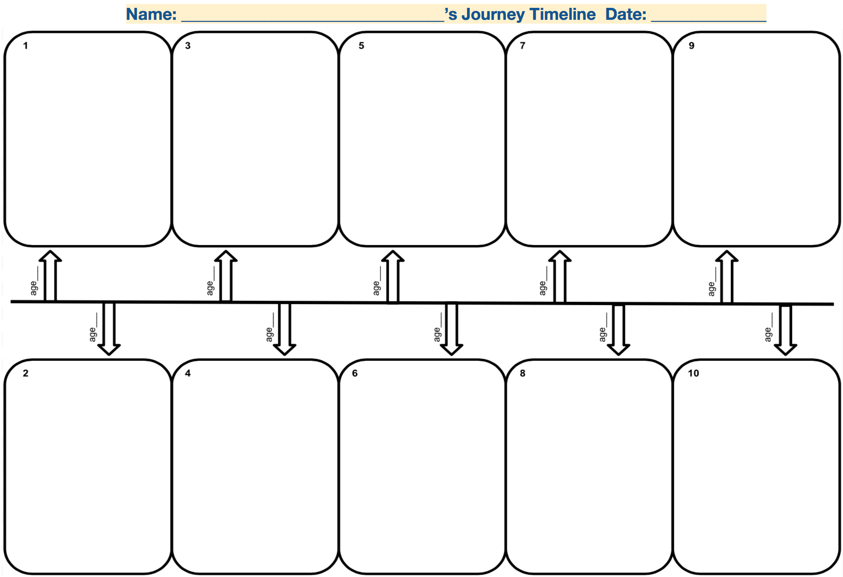
My Journey Timeline
Teacher models personal Journey Timeline here.
Options:
Project this slide onto a whiteboard and create in real time with a dry erase marker
Use a document camera to project your timeline worksheet in real time
Project an image of a pre-created timeline on a PPT slide.
4min
Notes:
4min: T=5
4min: Teacher models his/her personal journey timeline: You can project your journey timeline on a document camera or take a picture of it and project it as you explain it.
Teacher note: Being vulnerable, grateful, humble, optimistic and honest are all qualities that help us build rapport and trust with our students. This activity allows you to exhibit these qualities as you explain your journey timeline. You essentially are setting the tone for how students will share their own stories. Students can relate to personal challenges like a death in the family, failing at something, or other hardships/setbacks and it can serve as hope for many students who might currently be going through a similar situation. Sharing our journey helps us appear more relatable and approachable, however it is up to teacher discretion how much you want to share about yourself that would be still considered appropriate. If you are uncertain, please check with your schoosite principal.
Some students might describe some traumatic moments. This shows that they feel safe in your class to express it. Affirm that students are courageous and inspiring for sharing their story and that they are seeing these challenges as setups, not setbacks. They grew stronger and will use these experiences to propel them. If they need some time alone or aside, give them that space and tell them that you care for them and are there to support them. They also do not have to share these specific moments.

Slide 5
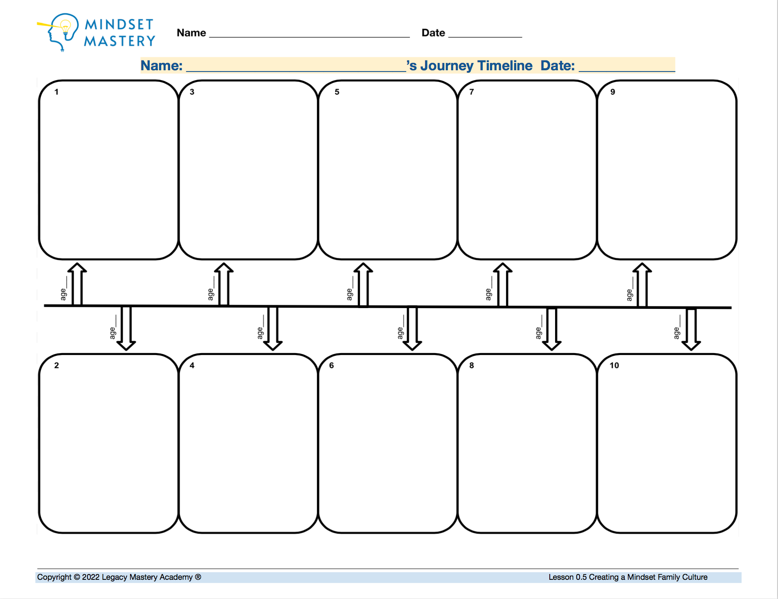
Create Your Journey Timeline
Take 15 minutes to:
Include at least 4 positive and 4 challenging events that have shaped who you are today.
State the event and explain how that event has shaped you.
Include your age if possible at each event.
Remember that being vulnerable, humble and honest helps us build trust.
Be ready to share with a partner!
16min
Notes:
16min: T=21
1min directions: “Now it is time for you to create your own journey timeline! Let’s review the guidelines....” (on slide)
15min student creating journey timelines:

Slide 6
Sharing Our Journey
Listener: Say this phrase: “I ____ promise to listen, honor, and respect your story with no judgement at all, just appreciation for what you’ve gone through in life. You can trust me. I’m excited to learn about your journey!” (30sec)
Presenter: Present by clearly showing your timeline to your partner and pointing to key events. Express how that moment shaped you as best as possible. Use your entire 4 minutes. (4min total)
Listener: Listen actively and without interrupting. Then: (90sec)
Ask any clarifying questions
Place one of your 3 stickers (or draw a star) on their timeline for each of these:
One thing that you had in common with your partner
One thing that inspired you
One thing you appreciate
Repeat for next partner!
14min
Notes:
14min: T=35
30sec state confirmation of trust and respect phrase.
4min presenter A shares journey timeline
90sec Q&A and partner B placing stickers with justification onto partner A’s journey timeline.
4min presenter B shares journey timeline
90sec Q&A and placing stickers with justification onto partner B’s journey timeline.
Extension Opportunity: If time allows, students can continue sharing their stories with other classmates, using the same protocol.

Slide 7
Experience Debrief
How did this experience help build a sense of trust, safety, respect, and empathy with your partner? (3min)
“This experience helped me build trust, safety, respect, and empathy with my partner by/because __________.”
EMPATHY: The ability to put yourself in someone else’s shoes in order to try to understand their situation and emotions.
(Click for sentence starters if needed)
5min
Notes:
5min: T=40

Slide 8
Stop Here
GOT FEEDBACK?
Do you have feedback, concerns, questions, and best practices to share?
Click here to complete our quick 1 min feedback form!

